Slide 1


Don Bosco Institute of Technology, Bangalore Department of Information Science & Engineering
Project Presentation
on
“Grain Adulteration Detection Using Deep Neural Network”
Presented by:
Name
MEGHANA S
USN
1DB20IS081
Under the guidance of
Dr.B.K.Raghavendra
Head of the Department,
Dept. of ISE
2023-2024

Slide 2
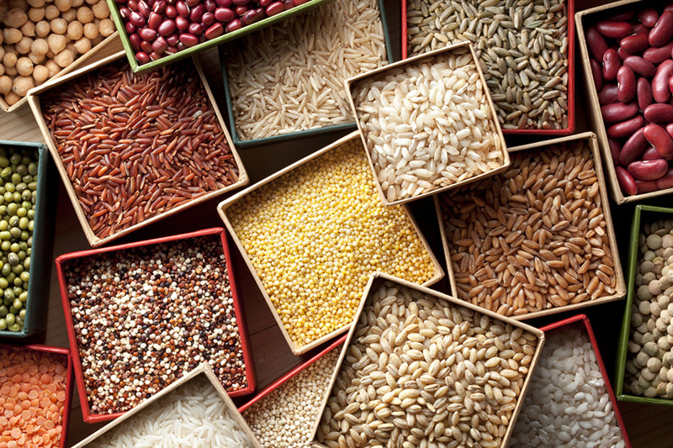
CONTENTS
Introduction
Aim and objectives
Literature survey
Problem statement
Proposed Block Diagram
Methodology
System requirements
Implementation
Snapshots
Conclusion
References

Slide 3
INTRODUCTION
India has a very long history of grain adulteration and consumption for producing low cost grains. Automation is utmost necessary when human inspection is misleading the society and selling cheap quality food.
This project illustrates the grading system which process the grain image digitally and classify the grains into pure and impure class by taking predefined values into consideration with the help of Digital Image Processing and the grains are easily distinguished.
This can be achieved by training the system with a set of images and using these results, the system will test the input image. It can automate the process which is reliable, factual and time saving ,life saving from the toxic disease which is going to caused by the adulteration.

Slide 4
AIM & OBJECTIVES
Aim: The aim of the project is to develop a system that utilizes deep neural networks to detect adulteration in grains effectively and efficiently.
Objectives:
To study the existing methods and technologies for grain adulteration detection.
To design and implement a deep neural network-based system for grain adulteration detection.
To collect and analyze data on different types of grains for training and testing the system.
To evaluate the performance of the system in accurately detecting adulteration in grains.
To provide recommendations for the implementation of the system in real-world scenarios to ensure food safety and quality.

Slide 5
LITERATURE SURVEY
Title | Author and year | Objectives | Technique | Observation Scope
Deep Neural Network Based Grain Adulteration Detection | Rajashekar S A, Abhishek GM, Jeswanth A L D 2023 | Demonstrates an automatic grading system that uses digital image processing to process grain images | IoT-based sensors, data analytics | Detection accuracy in identifying adulterants in various fruits, real-time monitoring capabilities
Selected food items adulteration,their impacts on public health,and detection methods: A review | Kasahun Desalegn, Hayat Hassen, Abdulmajid Haji 2023 | Recognize varieties and grade diseases accurately | Inception deep learning model | Precision in recognizing different fruit types and grading diseases across multiple species

Slide 6
Title | Author and year | Objectives | Technique | Observation Scope
Deep Neural Network-Based Sorghum Adulteration Detection in Baijiu Brewing | Shanglin Yang, Yang Lin, Yong Li, Defu xu, Suyi Zhang, and Lihui Peng, 2022 | Employ various image processing techniques for analysis | Image processing algorithms, sampling and observation. | Applicability to diverse diseases, robustness across different image processing methodologies
An overview of food adulteration: Concept,sources, impact,challenges, detection | Ankita Choudhary, Neeraj Gupta, Fozia Hameed and Skarma Choton, 2020 | Detect diseases in hydroponically grown plants | Leading-edge machine learning techniques, image processing | Accuracy in identifying diseases in plants grown in hydroponic systems
Effect of fermentation processing on the flavor of Baijiu | H. Liu and B. Sun, J. Agricult. Grain Chem, 2018 | Create a system for the detecting th effect of fermentation processing | IoT-based sensors, data analytics | Accuracy in detecting formalin presence in various fruits, real-time monitoring capabilities

Slide 7
PROBLEM STATEMENT
Identifying grain adulteration can be a challenging task, even for farmers and buyers who may not have the expertise to detect adulterants in grains. Traditional methods of grain quality control are often expensive, labor-intensive, and prone to errors. Identification of grains, weather adulterated or not is a difficult activity sometimes leading to uncertainty. By some features like size, shape and color adulterated grains can be classified. The project aims to tackle this problem by developing a deep neural network-based system that can accurately detect and classify adulterants in grains, providing a more efficient and reliable solution for ensuring food safety and quality.

Slide 8
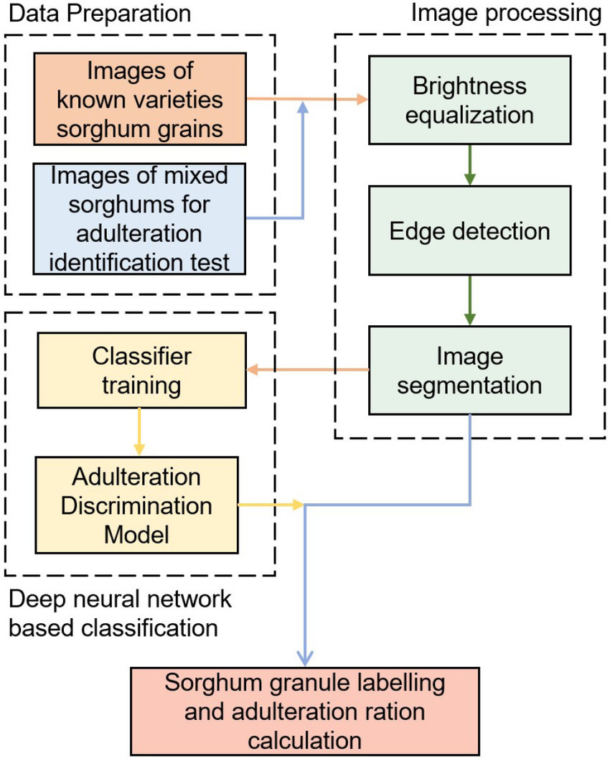
PROPOSED BLOCK DIAGRAM

Slide 9
METHODOLOGY
Brightness equalization:
When taking pictures to acquire images, the uneven illumination caused shadows in the background, which will affect the edge detection effect and also lead to differences in the histogram distribution of color space between segmented images, reducing the data uniformity.
Hence, it is necessary to identify and subtract the background, and adjust the image to equalize the brightness.

Slide 10
METHODOLOGY
2) Edge detection:
Edge detection plays a crucial role in identifying the boundaries of objects or features within an image.
Initially, the image is converted to grayscale to simplify processing and reduce computational complexity.
Low-pass filtering methods such as Gaussian blur are applied to the grayscale image to remove noise and smooth out the intensity variations.
Then find the outside contours of each connected component using the Canny edge detector . The corresponding low and high thresholds for gray scale gradient are 100 and 200 respectively.

Slide 11
METHODOLOGY
3) Image segmentation:
Image segmentation involves partitioning an image into distinct regions or objects based on certain criteria, such as color, intensity, or texture.
The Douglas-Peucker algorithm is utilized to approximate the contours of objects within the image, reducing the complexity of the contour representation while preserving essential shape characteristics.
To preserve the size information of the grains, we used square with fixed side length (140 pixels) to segment each granule.
The square has the same center as the bounding rectangle, and its side length is larger than the maximum value among the long sides of the rectangles.

Slide 12
SYSTEM REQIREMENTS
HARDWARE REQUIREMENTS
System : intel i3/ i5 2.4 GHz.
Hard Disk : 500 GB
Memory (RAM) : Minimum 4 GB , Recommended 4 GB or above
Storage : 4GB or higher free drive space/cloud space
SOFTWARE REQUIREMENTS
Operating system : Compatible with Windows, Linux and Mac
Software Tool : OpenCV for image processing
Deep Learning Framework : TensorFlow, PyTorch or similar for implementing neural networks
Coding Language : Python
Toolbox : Image processing toolbox

Slide 13
IMPLEMENTATION
Step 1: Load the Pre-Trained YOLOv5 Model
Utilize the PyTorch library to load a pre-trained YOLOv5 model that has been trained on a large dataset to recognize various objects.
Step 2: Define Preprocessing Functions
Prepare image data for object detection by defining preprocessing functions.
Tasks include resizing images to a fixed size required by the model, normalizing pixel values to a certain range, and applying any other necessary transformations to enhance model performance.
These preprocessing steps ensure that the input images are in the correct format and ready for effective processing by the YOLOv5 model.

Slide 14
IMPLEMENTATION
Step 3: Implement Object Detection Algorithms
Feed the preprocessed images into the loaded YOLOv5 model to perform inference and detect objects within the images.
The model outputs bounding box coordinates, class predictions (e.g., pure or impure dal grains), and confidence scores for each detected object.
Step 4: Apply Non-Maximum Suppression (NMS)
Refine the detection results using Non-Maximum Suppression (NMS) to eliminate redundant bounding boxes that cover the same object.
Step 5: Calculate the Count of Pure and Impure Dal Grains
This quantitative data provides insights into the proportion of pure vs. impure grains in a sample, which can be valuable for quality control in food processing and packaging industries.

Slide 15

SNAPSHOTS

Slide 16
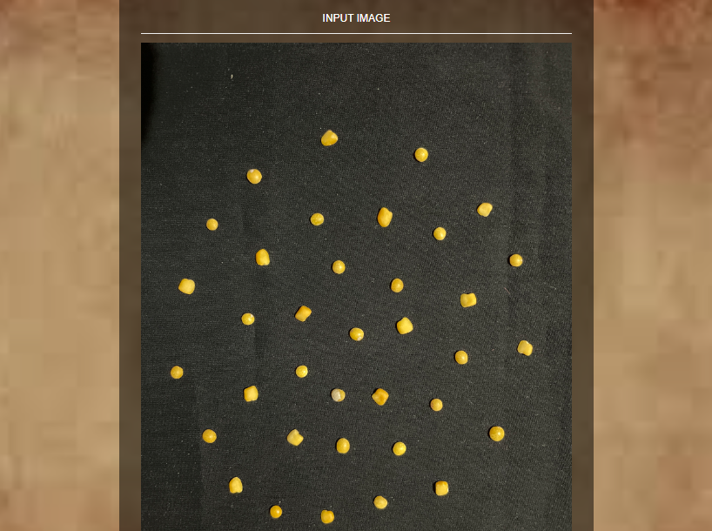
SNAPSHOTS

Slide 17
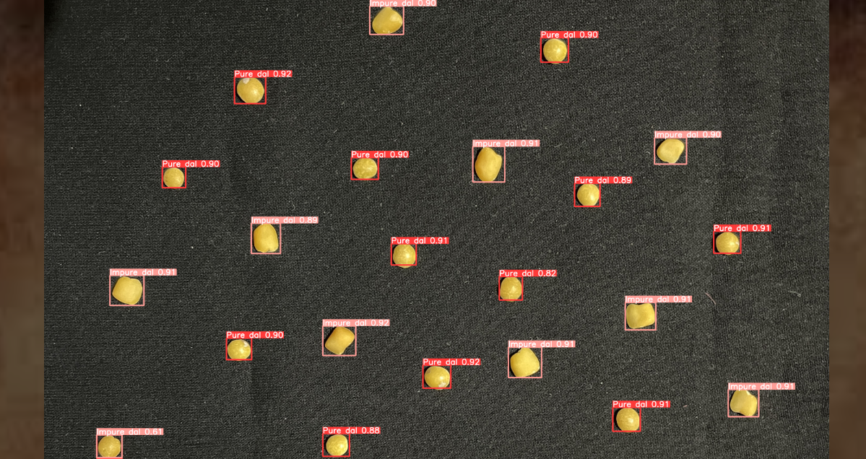
SNAPSHOTS

Slide 18
CONCLUSION
In conclusion, the utilization of these sophisticated computational models, particularly neural networks, can demonstrate their efficiency in accurately identifying and classifying adulterants in grain samples. The implementation of such technology not only enhances the efficiency of grain quality control processes but also contributes to safeguarding public health by minimizing the risk of consuming adulterated food products. By using neural networks , it can offer a scalable and adaptable solution that can be fine-tuned for different grain varieties and types of adulterants, providing a versatile tool for the agricultural and food industries.

Slide 19
REFERENCES
[1] Kasahun Desalegn, Hayat Hassen, Abdulmajid Haji "Selected food items adulteration, their impacts on public health, and detection methods: A review", Sep.2023, doi: 10.1002/fsn3.3732.
[2] Shanglin Yang, Yang Lin, Yong Li, Defu xu, Suyi Zhang, and Lihui Peng(Senior Member, IEEE)"Deep Neural Network-Based Sorghum Adulteration Detection in Baijiu Brewing" July.2022, doi: 10.1109/OJIM.2022.3190024.
[3] Vishwesh Nagamalla, B. Muthu Kumar, Neha Janu, Anusha Preetham, Syam Machinathu Parambil Gangadharan, Mejdal A. Alqahtani and Rajnish Ratna "Detection of Adulteration in Food Using Recurrent Neural Network with Internet of Things", June.2022, doi: 10.1155/2022/6163649.
[4] Ankita Choudhary, Neeraj Gupta, Fozia Hameed and Skarma Choton"An overview of food adulteration:Concept,sources,impact,challenges,detection“,Jan.2020,doi:10.22271/chemi.2020.v8.i1am.8655.
[5] H. Liu and B. Sun, “Effect of fermentation processing on the flavor of Baijiu,” J. Agricult. Grain Chem., vol. 66, no. 22, pp. 5425–5432, 2018, doi: 10.1021/acs.jafc.8b00692.

